Slide 1
NANOSCOPE MINIMALLY INVASIVE TECHNOLOGY
Paolo bernante
Alma mater studiorum universita’ degli studi di bologna
Centro di chirurgia metabolica e dell’obesita’

Slide 2
DISCLOSURE
CONSULENTE DI UNIBO PER MEDTRONIC

Slide 3
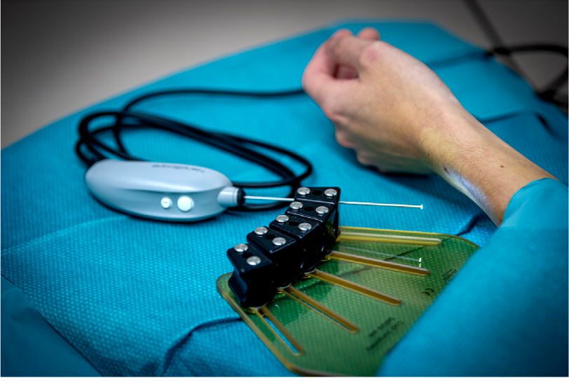
The NanoScope (Arthrex, Naples, FL) is a new instrument for arthroscopy with a diameter of 1.9 mm.

Slide 4
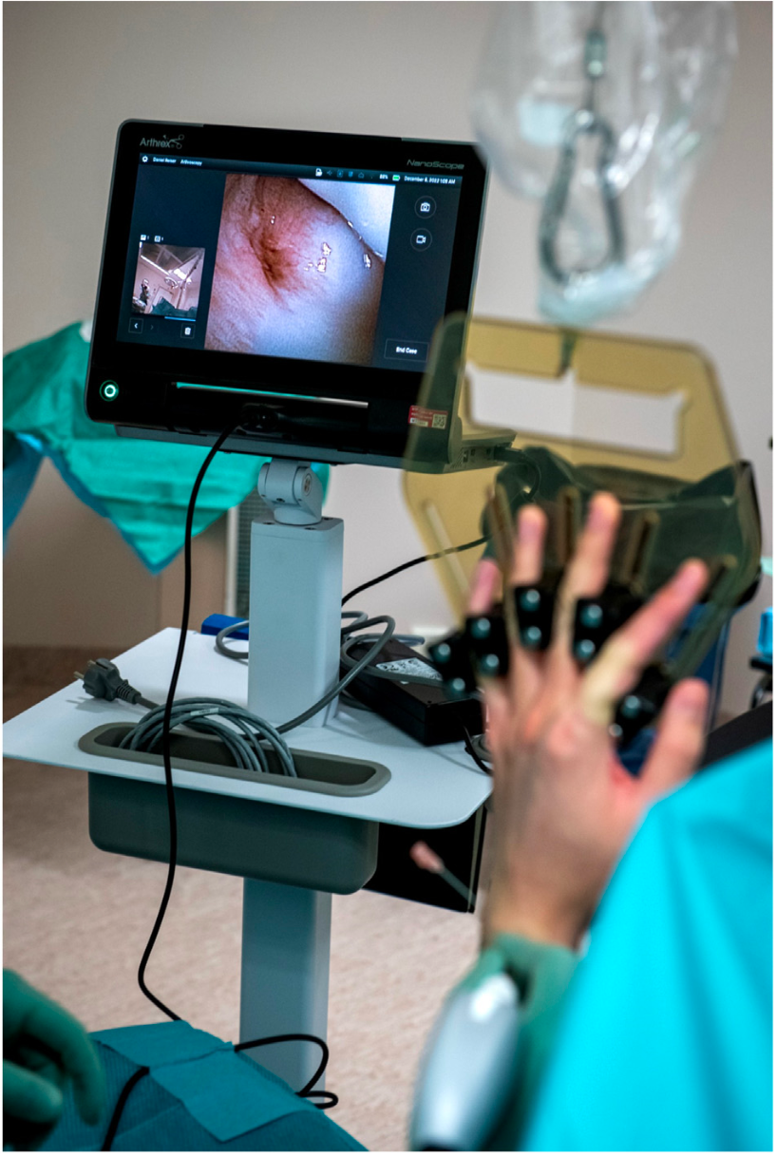
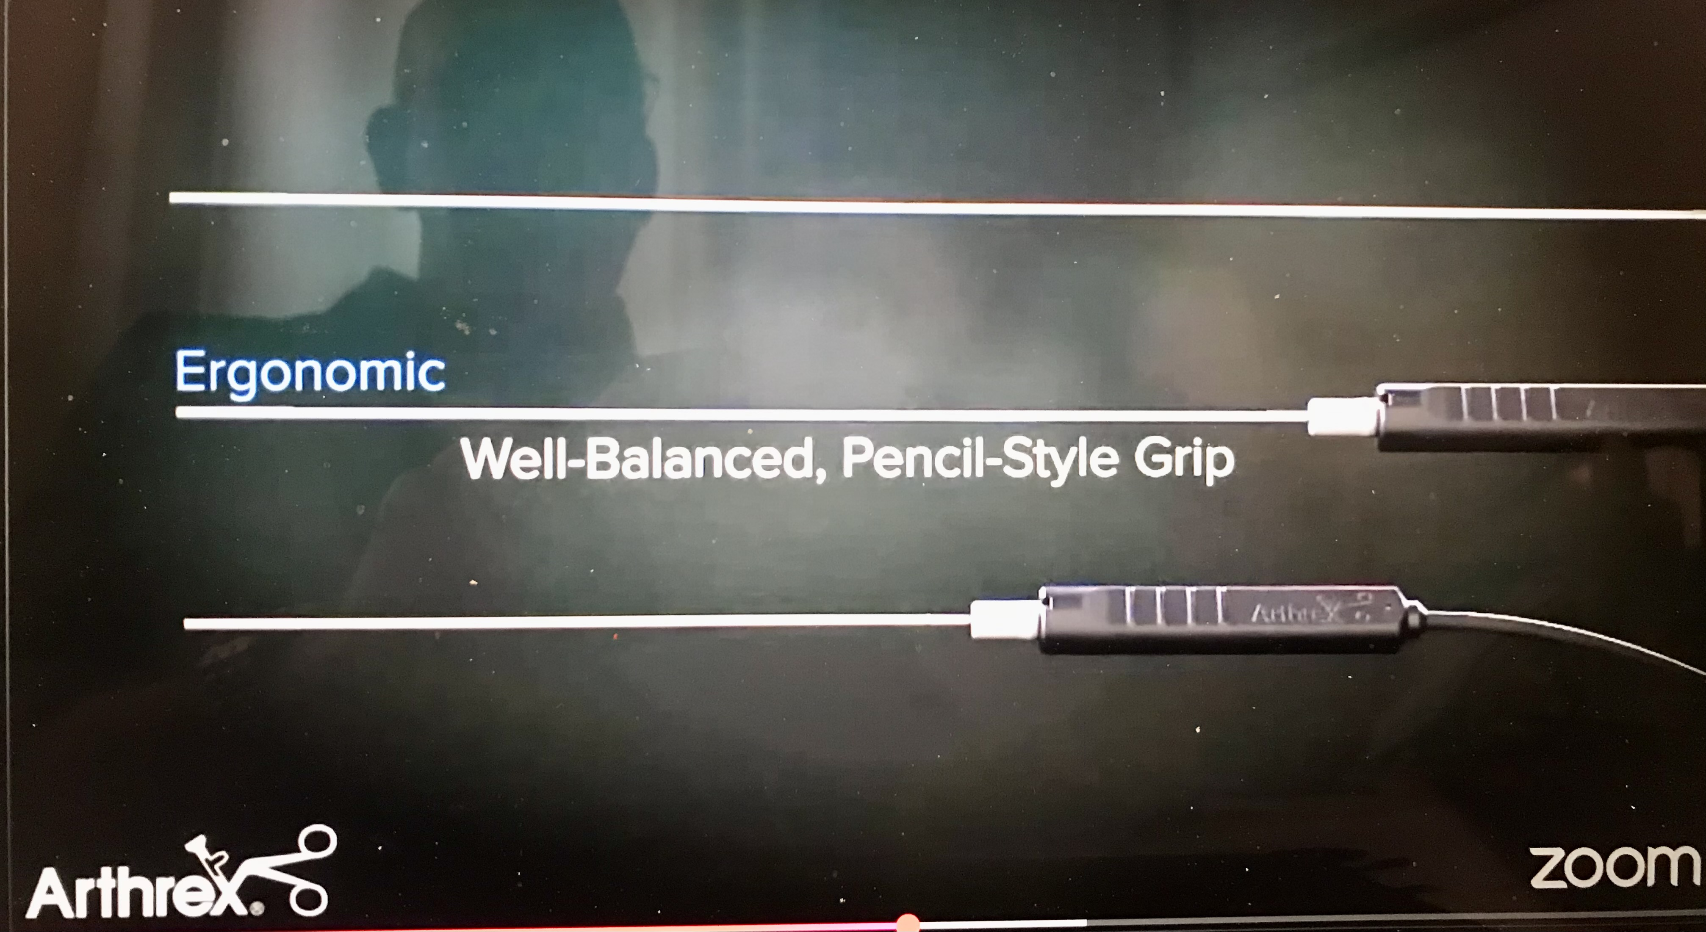
Utilizing a so called “chip-on-tip” technology, the instrument has a 120° panoramic field of view, looking straight on.
The chip-on-tip system is flexible
The system is a valuable diagnostic tool for single use, and is attached to a portable screen

Slide 5
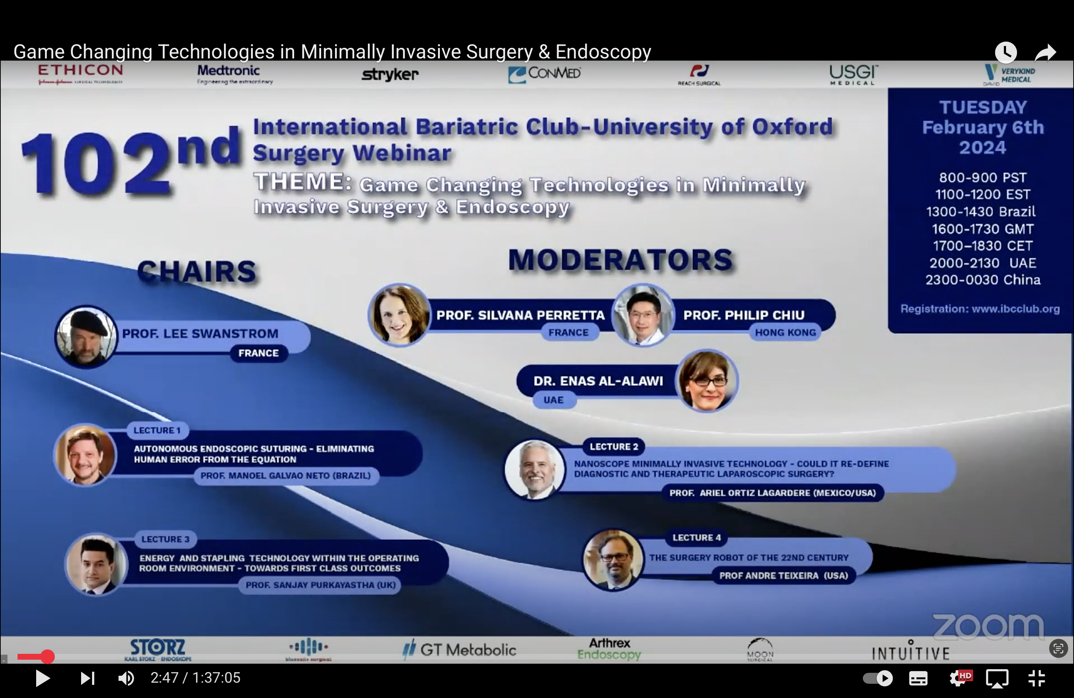

Slide 6
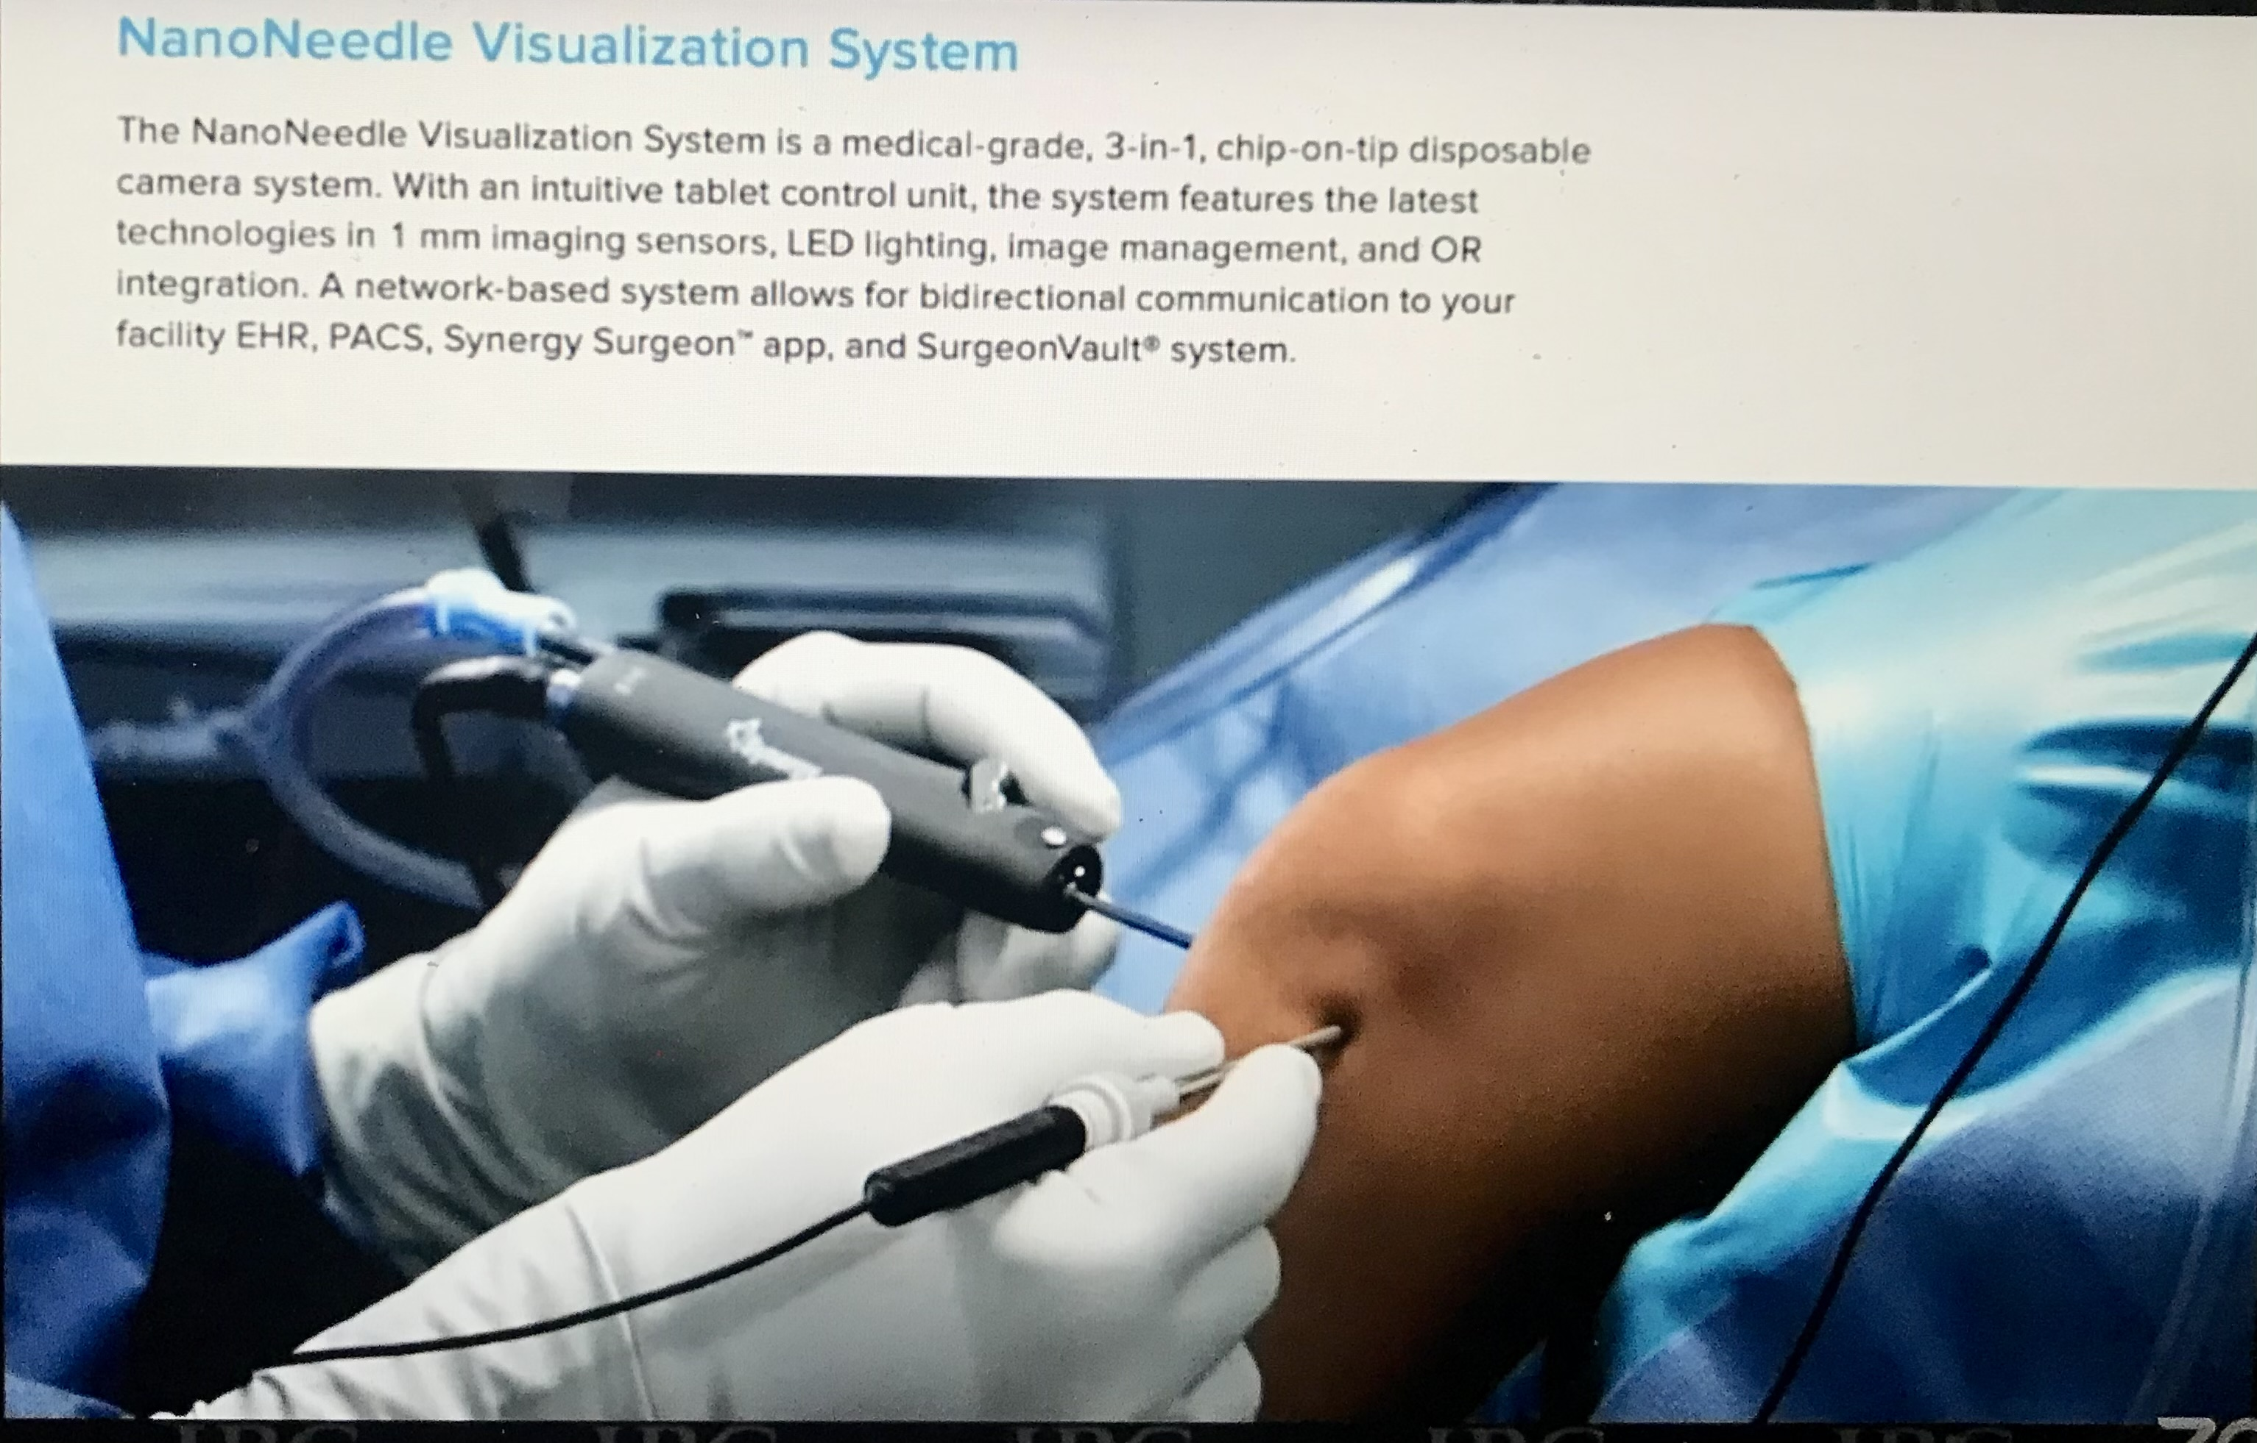

Slide 7
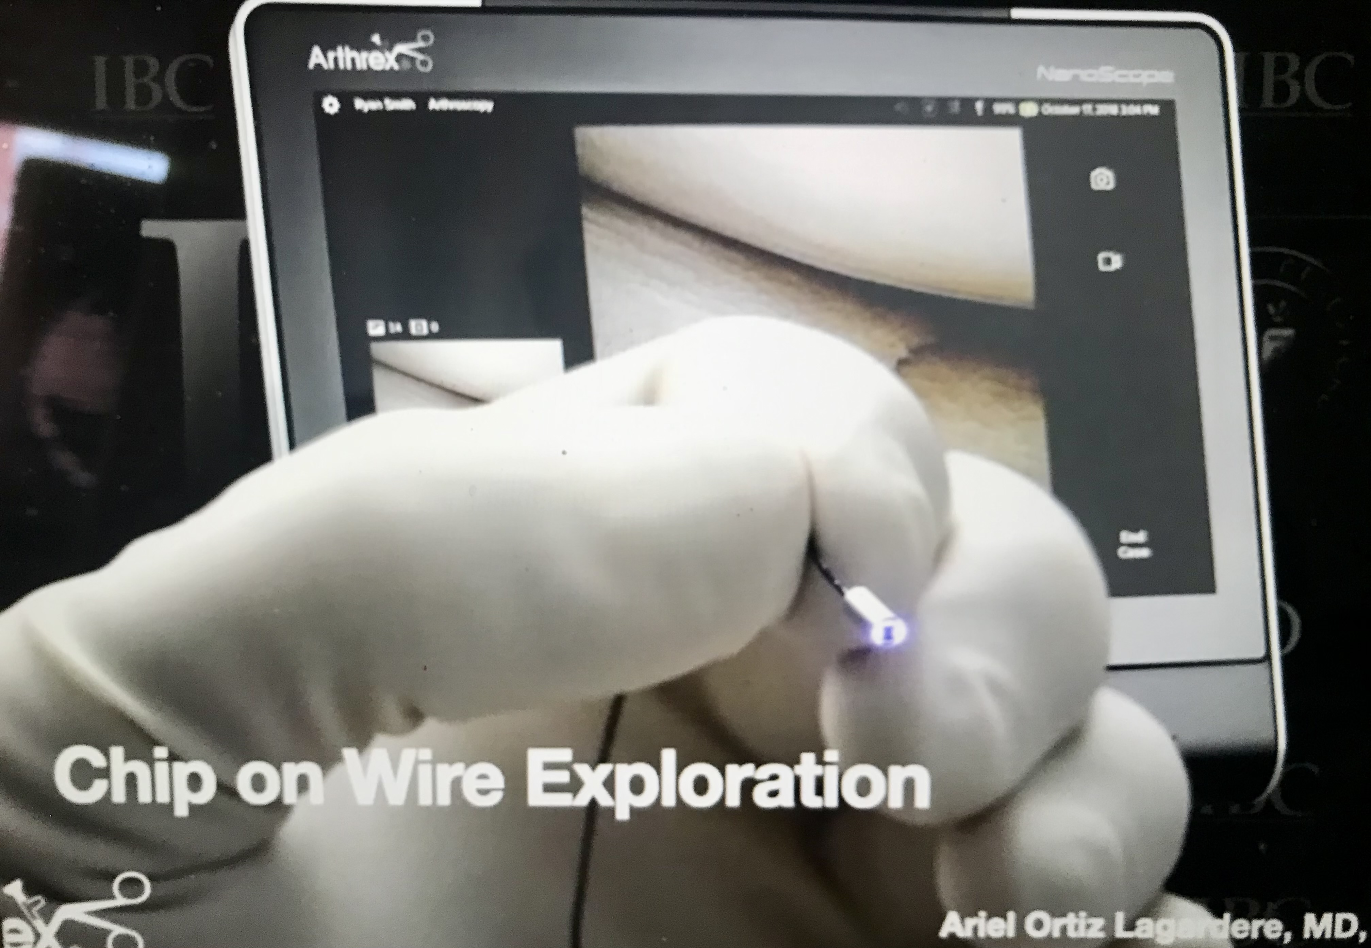

Slide 8
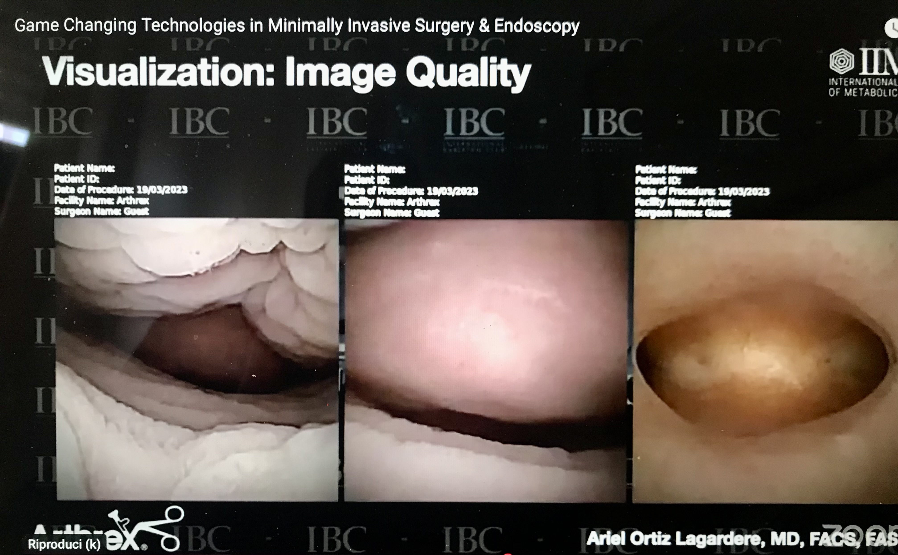

Slide 9
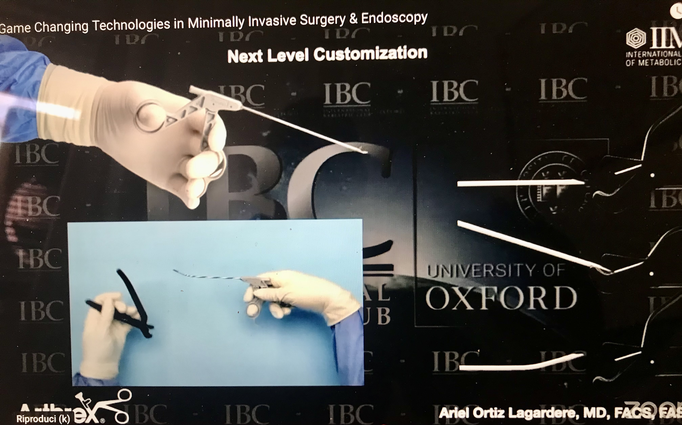

Slide 10
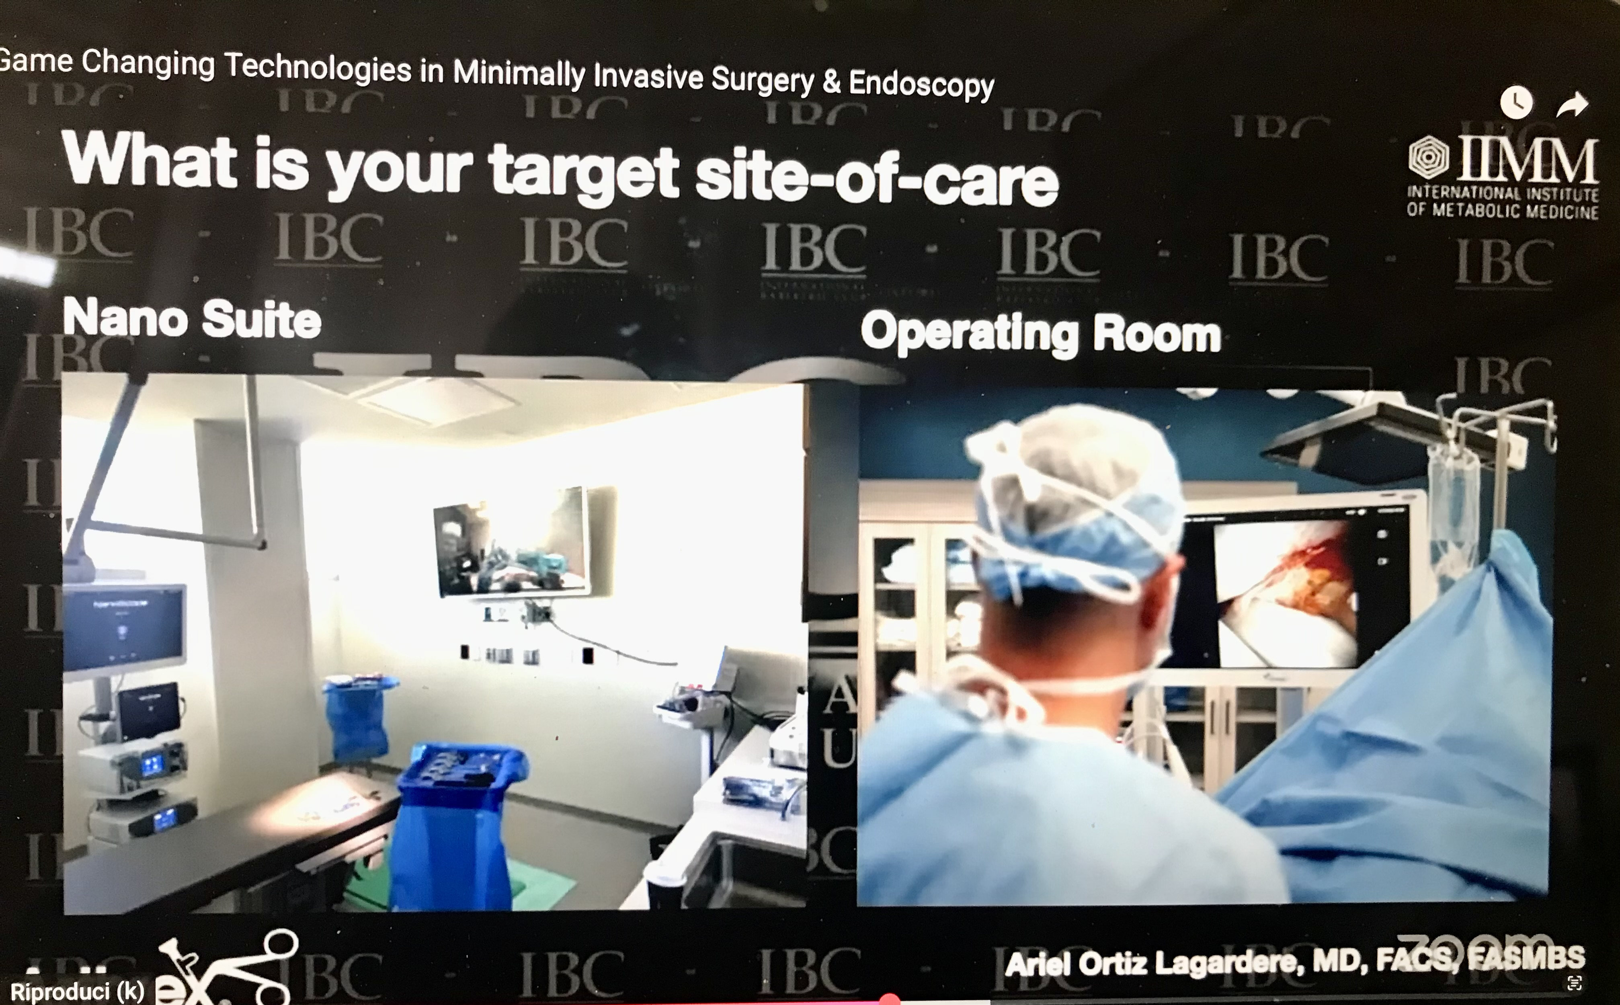

Slide 11
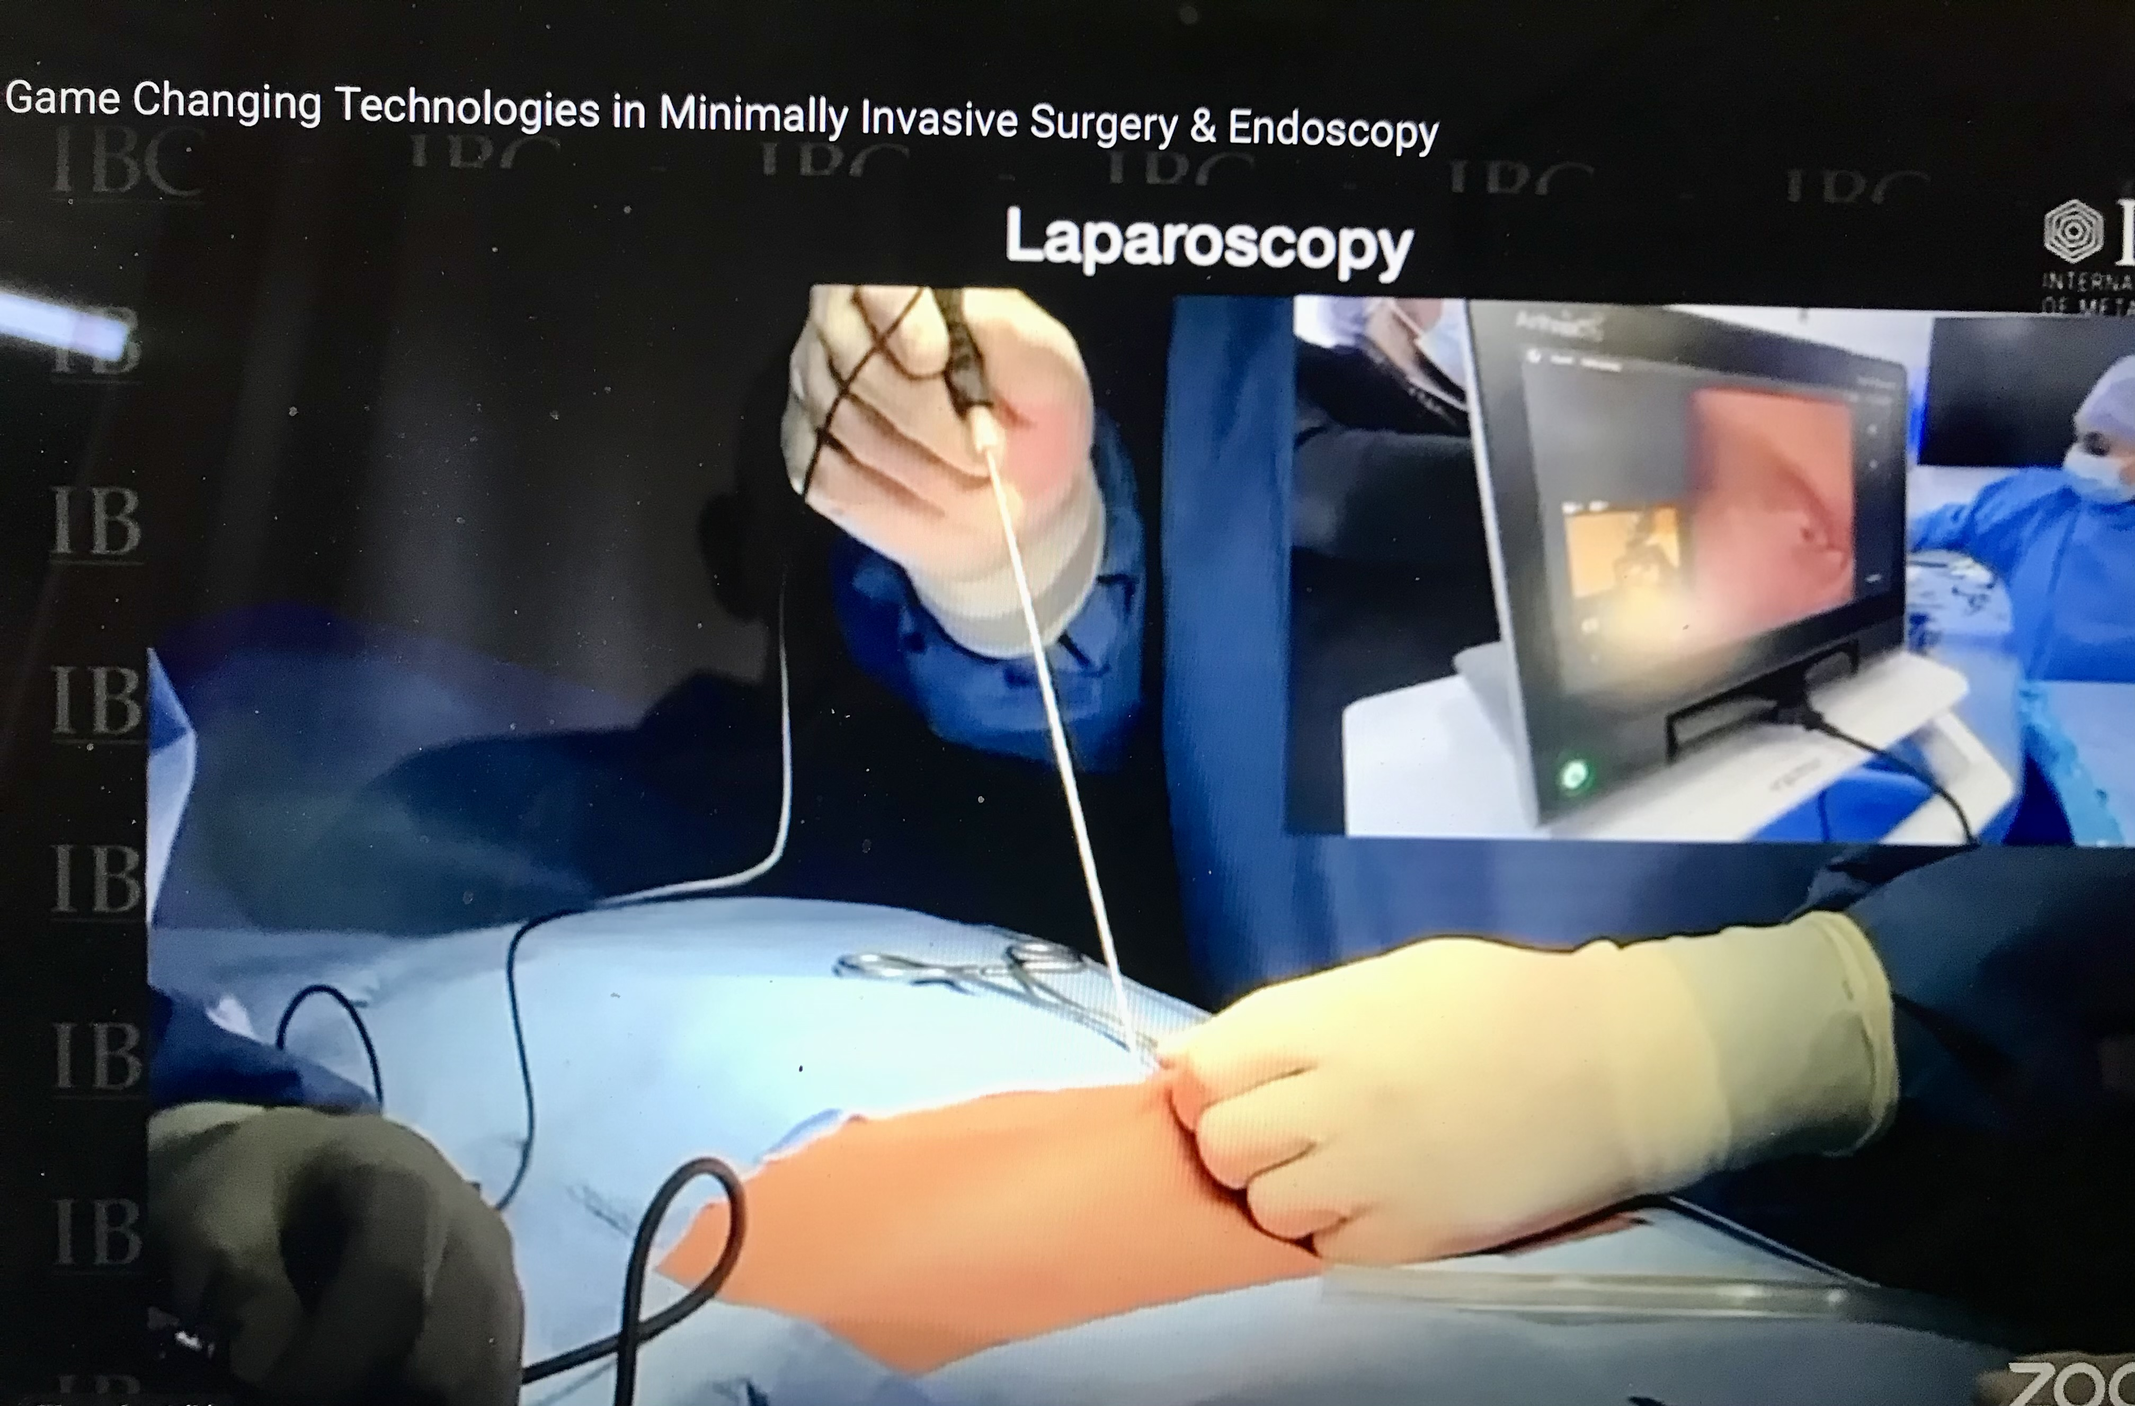
DIAGNOSTICA
PER
ENDOMETRIOSI

Slide 12
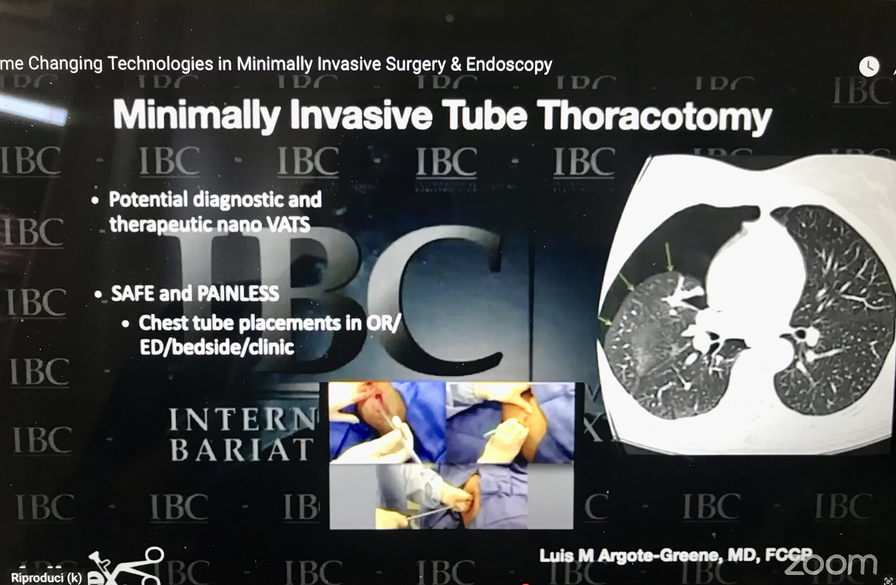

Slide 13
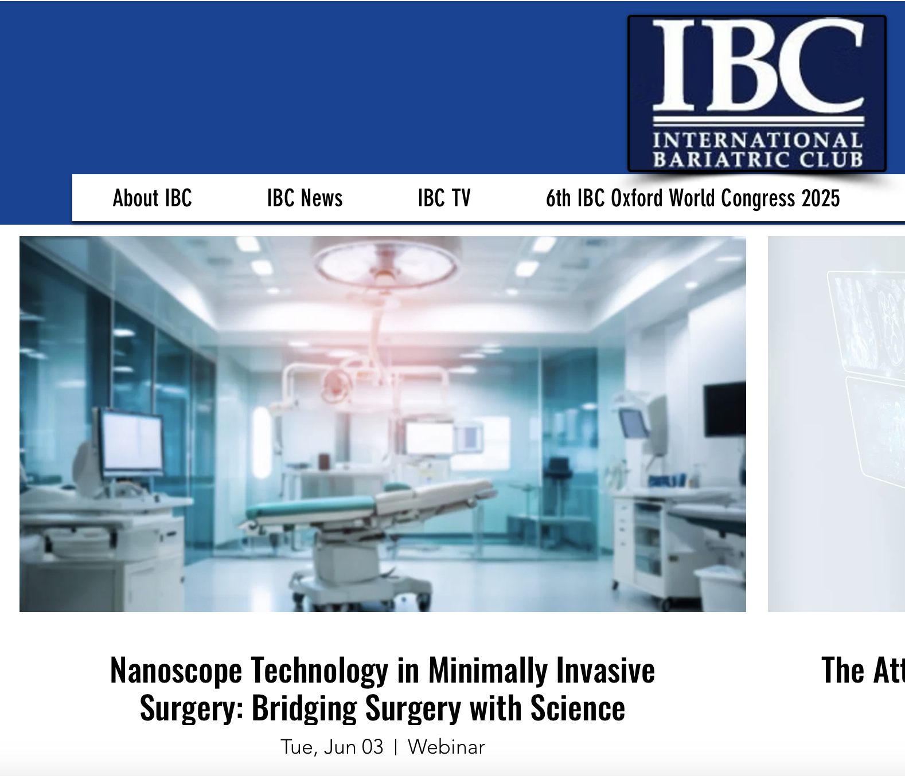
Nanoscope technology in pediatric surgery
Benefits and potential applications in adult minimally invasive surgery
Benefits and potential applications in emergency general surgery

Slide 14

NANOSCOPE MINIMALLY INVASIVE TECHNOLOGY IN BARIATRIC PATIENTS???

Slide 15
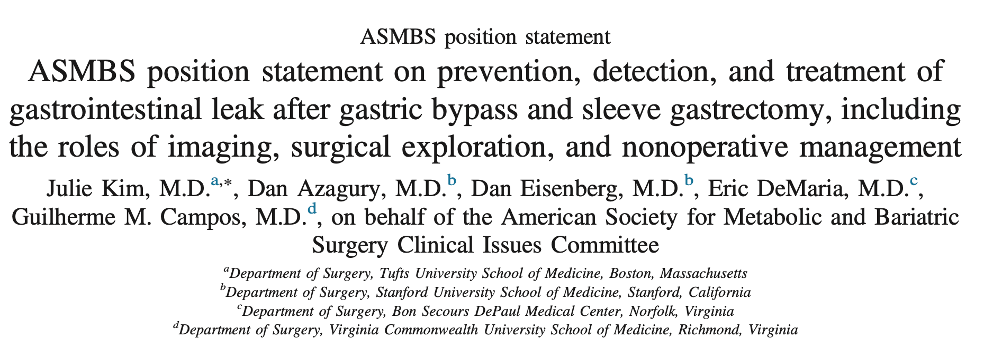
Laparoscopic or open reexploration is an appropriate diagnostic option, regardless of the feasibility of obtaining a postoperative imaging test, when a GI leak is suspected.
Reexploration is characterized by a higher sensitivity, specificity, and accuracy than any other postoperative test to assess for leak and should be considered the definitive assessment for the possibility of a leak. Although invasive and not without potential difficulty or morbidity, several studies have reported that reexploration is a well-tolerated intervention compared with the consequences of peritonitis, excessive inflammatory response, sepsis, organ failure, and mortality, which may develop when diagnosis and treatment of a leak are delayed. Thus, reexploration should be considered in patients with a suspected leak, and it is important to note that reliance on false-negative imaging studies may delay operative intervention, particularly when there is a leak at sites other than the gastrojejunostomy (e.g.,the gastric remnant or the jejunojejunostomy)

Slide 16
Grazie

